Slide 3
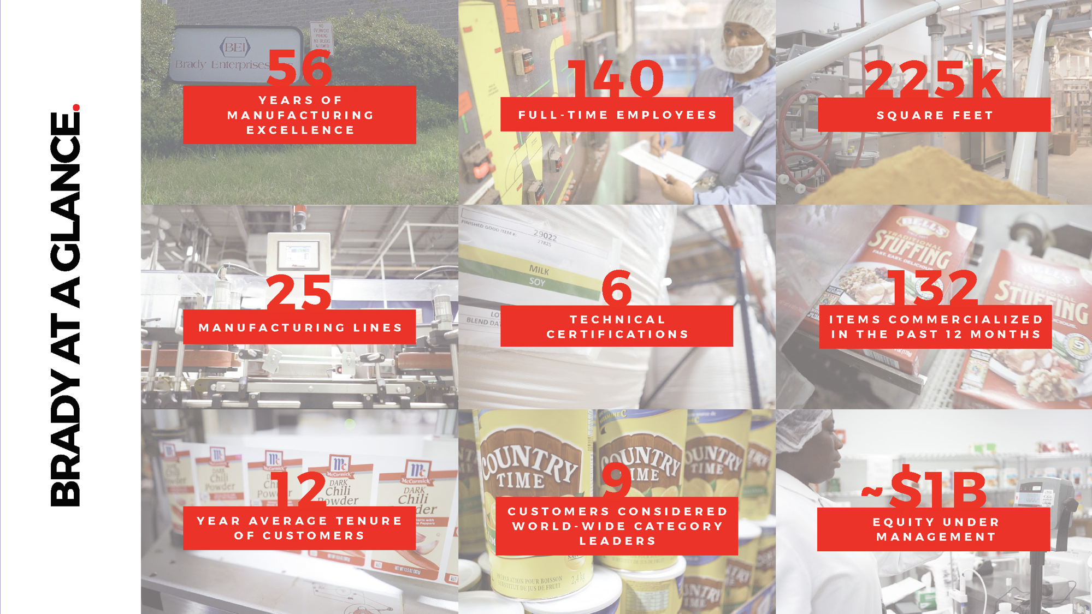

Slide 5
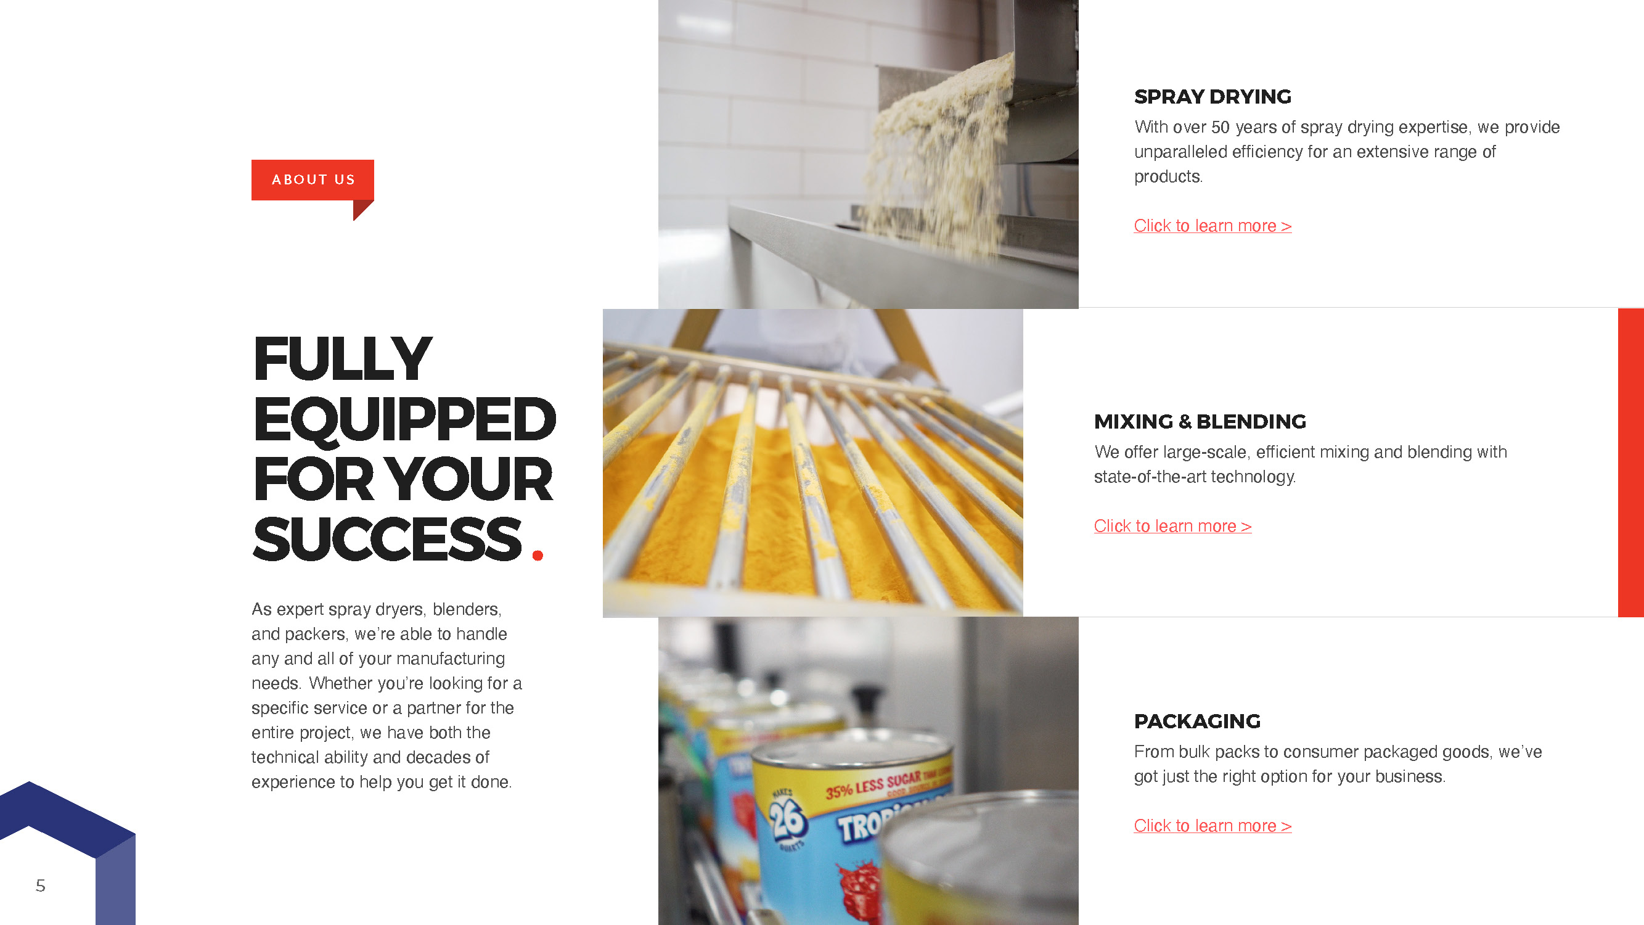
Click to learn more >
Click to learn more >
Click to learn more >

Slide 7
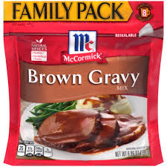

Slide 8
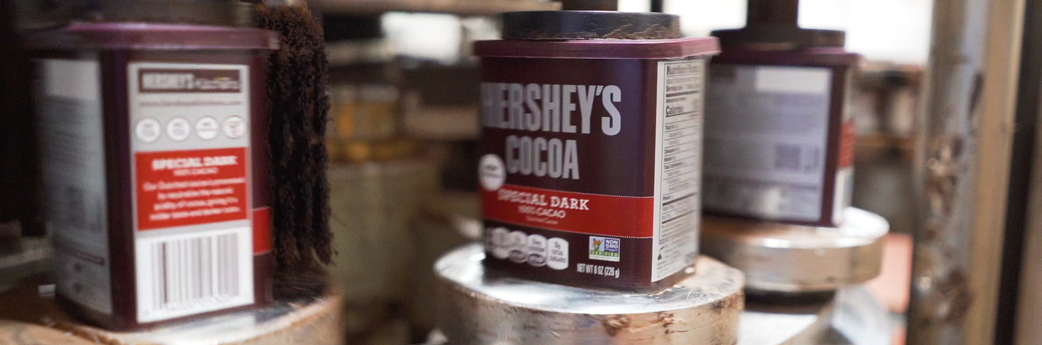

Slide 9
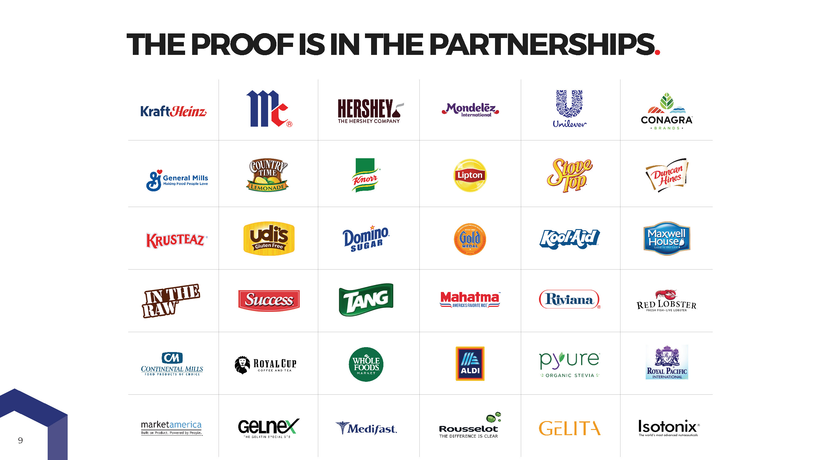
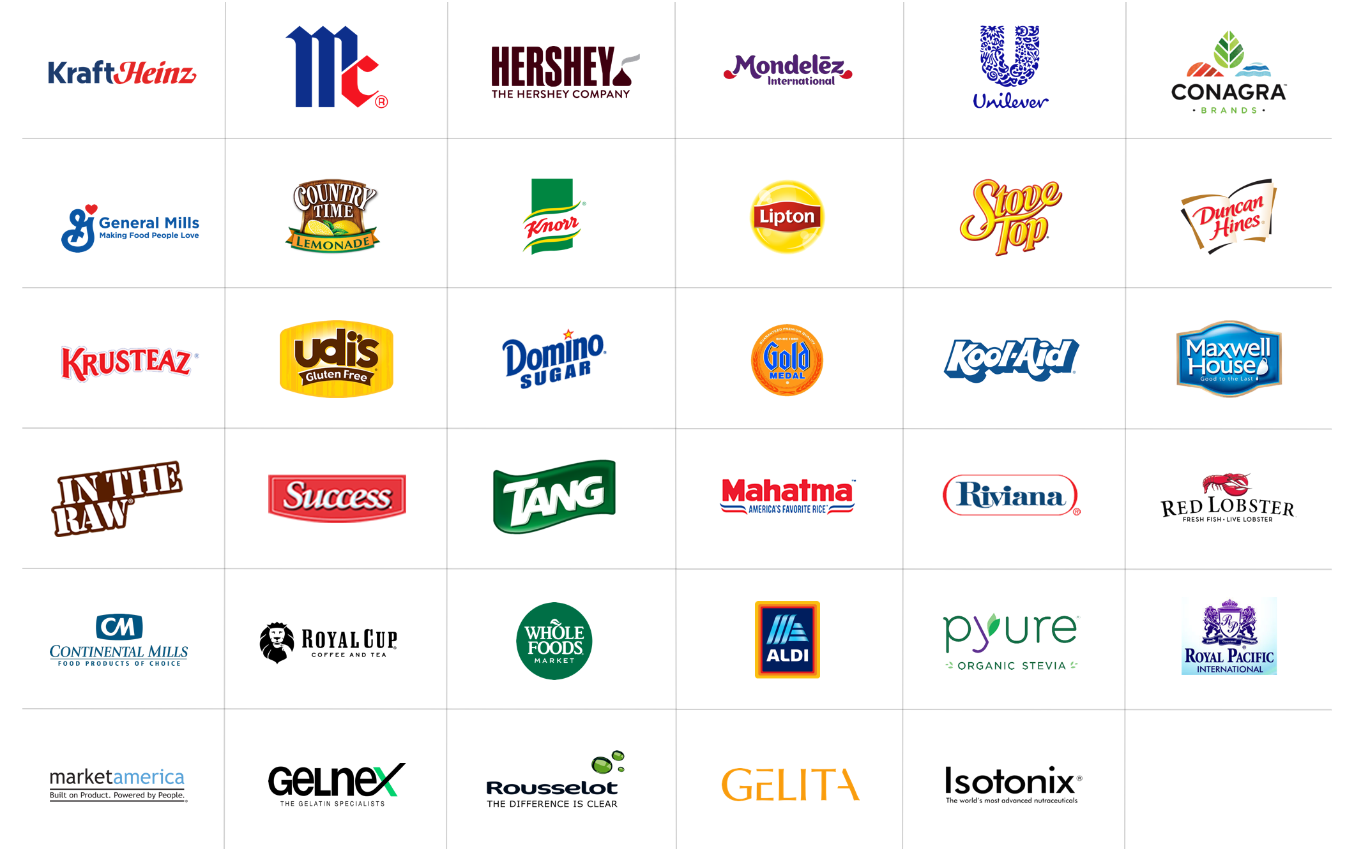

Slide 17
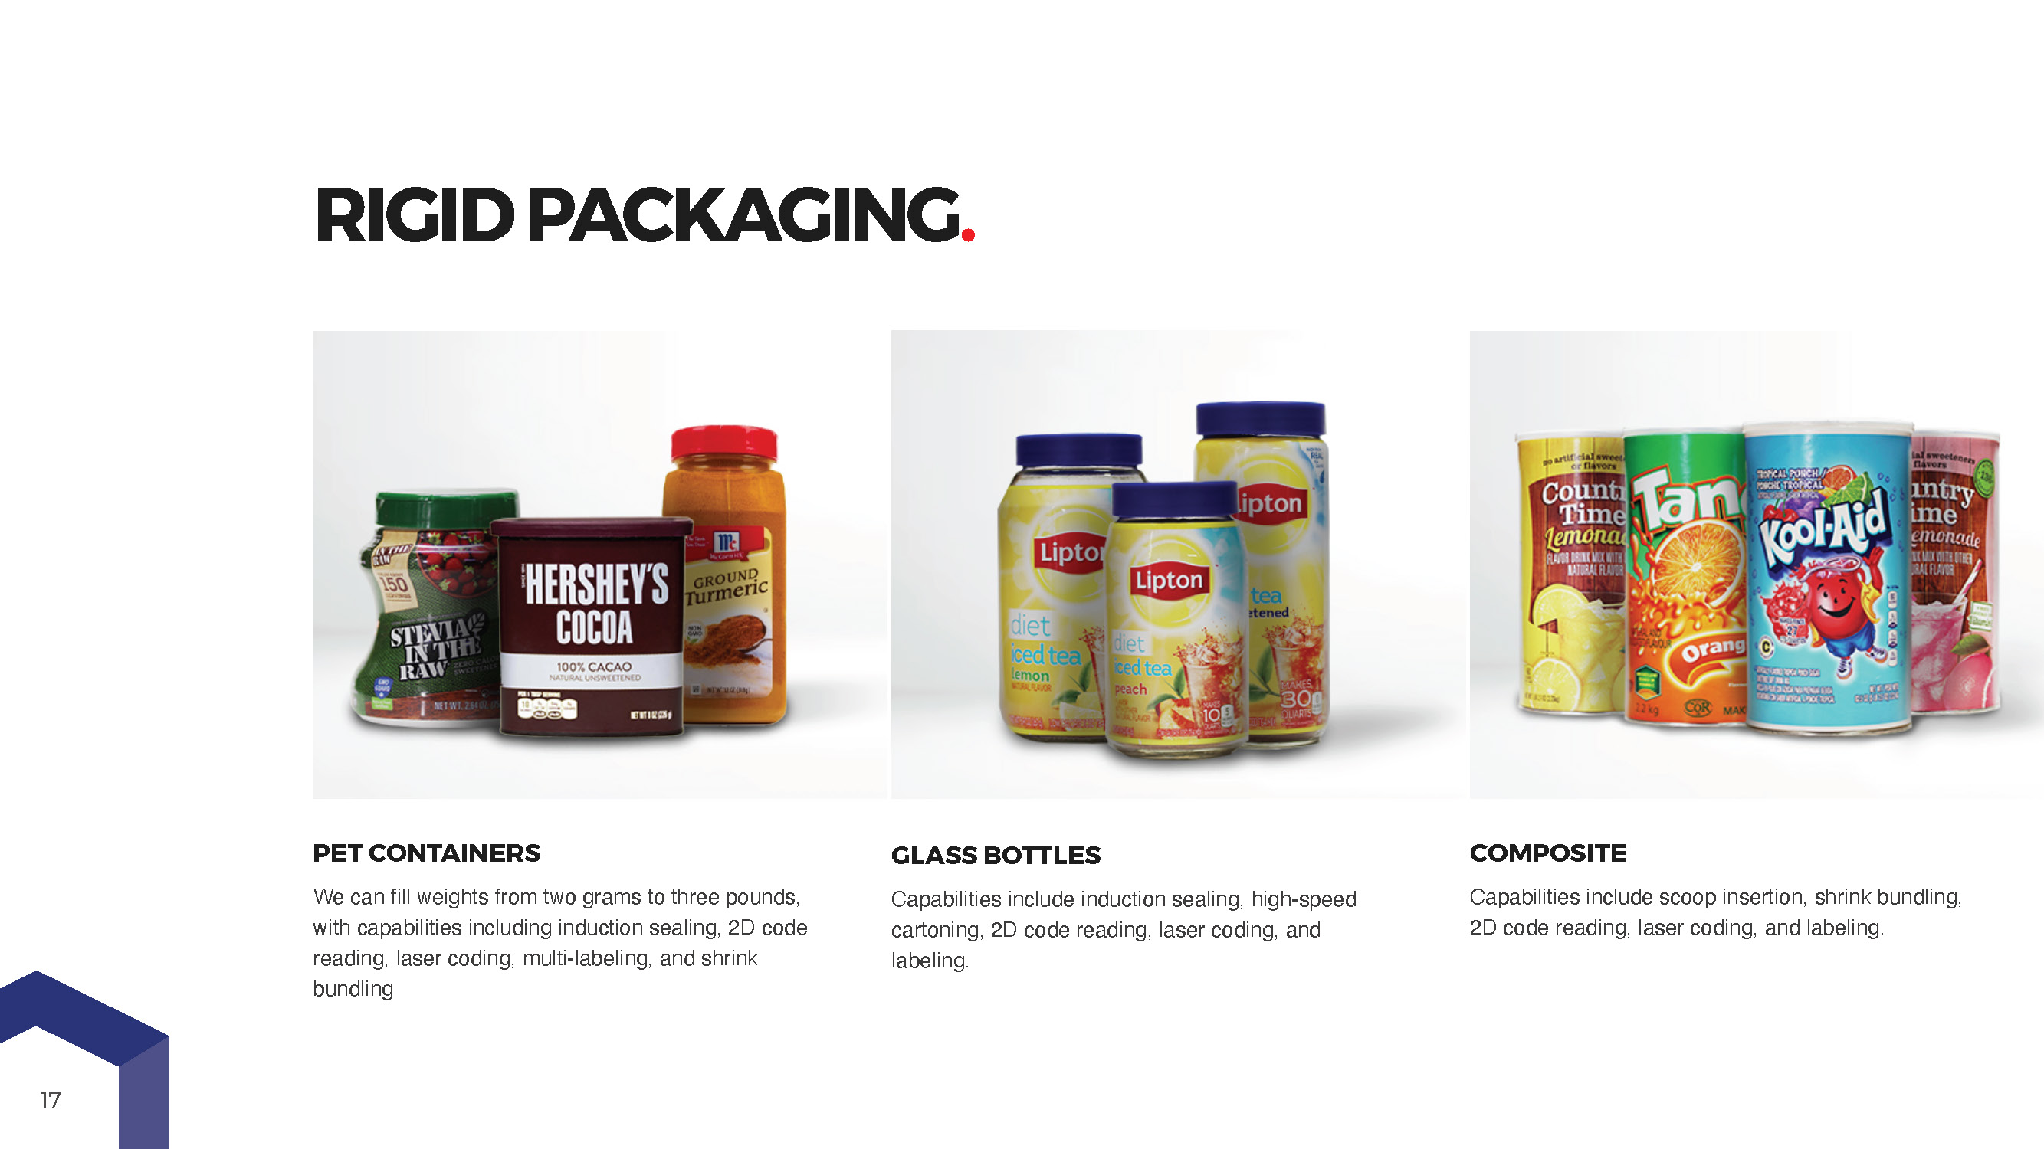

Slide 24
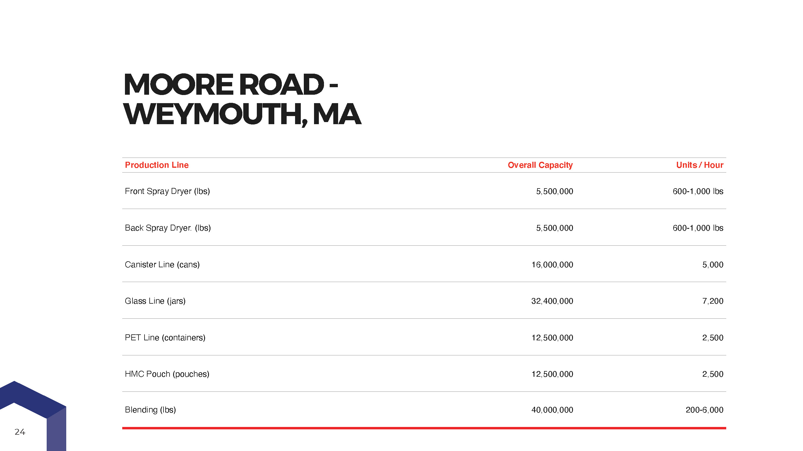

Slide 26
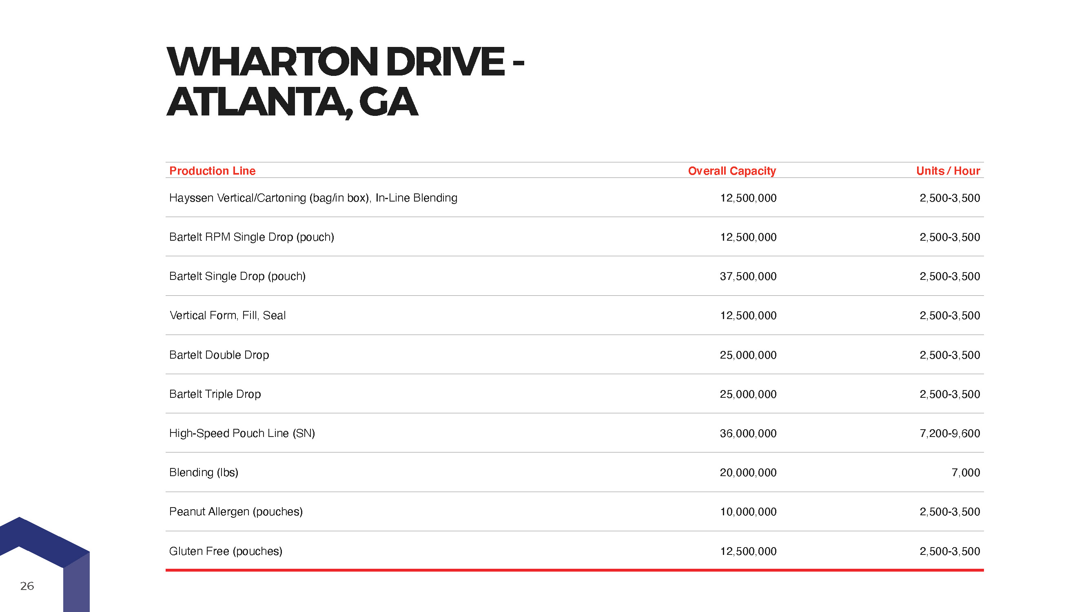

Slide 30
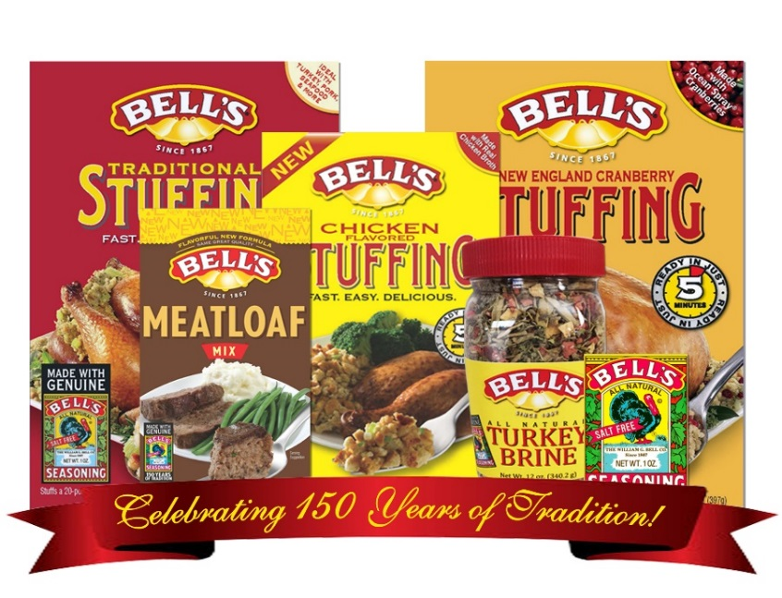
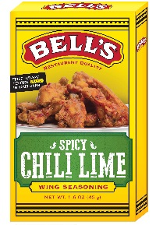
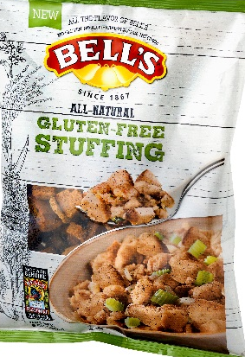
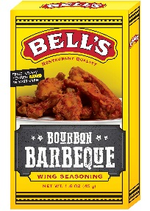
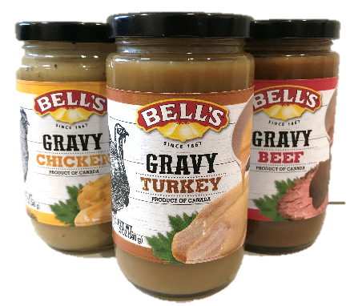
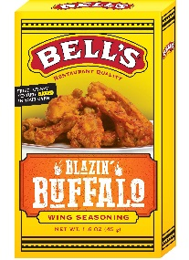
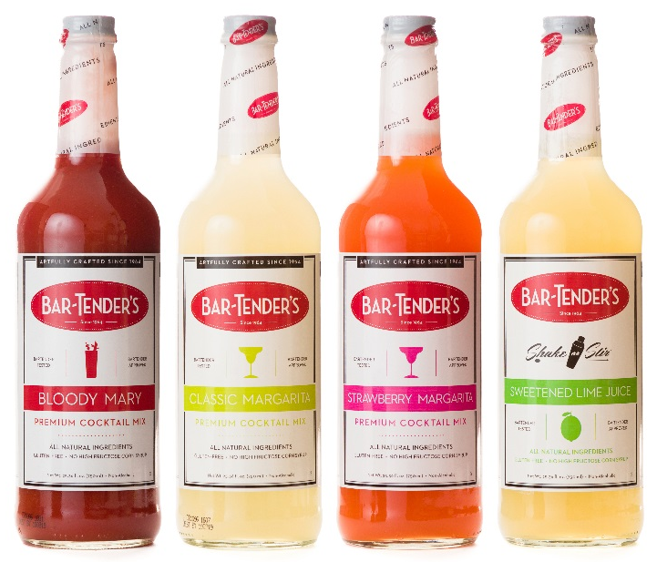
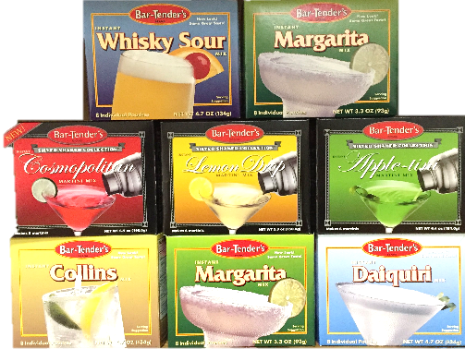
BELL’S
Oldest Seasoning/Spice brand in the US - Founded in 1867
Iconic Thanksgiving traditions in millions of homes throughout the country
Recently launched items include: Gravy, Rice Sides, and Purely Potatoes.
BAR-TENDER’S
Powdered Cocktail Mixes launched in 1964 that enable the home bartender to pour the perfect drink every time
Beloved throughout the US for their nostalgia and convenience
Recent liquid launches include: Classic Margarita, Bloody Mary, and Just Lime Juice
KLERELY360
Collagen Peptides made from pharma-grade bone gelatin
100% Sourced and manufactured in the US
Filtered to remove the usual odor and after-taste associated with collagen

